Slide 1
Computer Organization and Architecture Lecture 6 18th Oct, 2010
Dr. Hammad Afzal

Slide 2
Brief outline of today’s talk
A quick recap of last week: Inter-connections
Bus

Slide 3
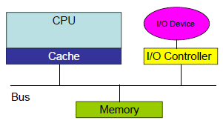
Inter-connection structures
Computer consists of set of components or modules of three basic types.
All the units must be connected.
Different type of connection for different type of unit
Memory
Input/Output
CPU

Slide 4
Inter-connection structures (2)
Memory
N words of equal length. Each word is assigned a unique numerical address (0,1,...,N-1).
A word of data can be read from and written into memory.
Nature of operation is indicated by read and write control signals.
I/O Module
From internal (to the computer system) point of view, I/O is functionally similar to memory.
Two operations, read and write.
I/O module may control more than one external device.
We can refer to each of the interfaces to an external device as a port and give each a unique address (e.g. 0,1,..M-1)
I/O module may be able to send interrupt signals

Slide 5
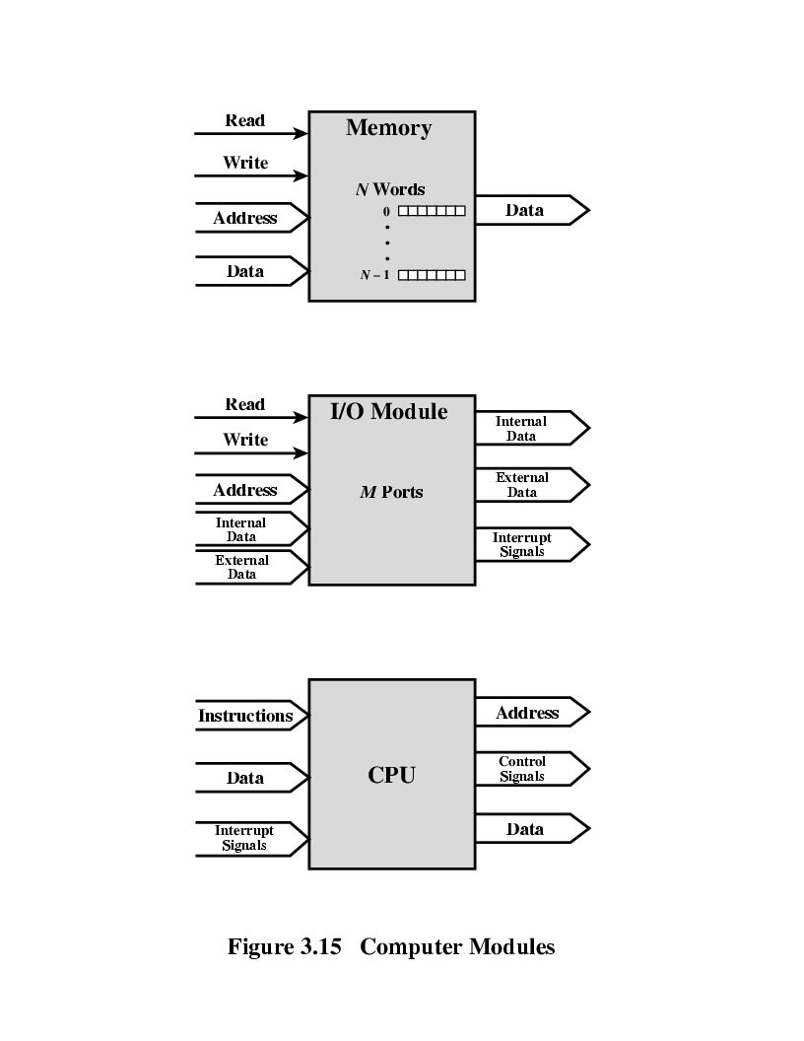
Computer Modules

Slide 6
Memory Connection
Receives and sends data
Receives addresses (of locations)
Receives control signals
Read
Write
Timing

Slide 7
Input/Output Connection(1)
Similar to memory from computer’s viewpoint
Output
Receive data from computer
Send data to peripheral
Input
Receive data from peripheral
Send data to computer

Slide 8
Input/Output Connection(2)
Receive control signals from computer
Send control signals to peripherals
e.g. spin disk
Receive addresses from computer
e.g. port number to identify peripheral
Send interrupt signals (control)

Slide 9
CPU Connection
Reads instruction and data
Writes out data (after processing)
Sends control signals to other units
Receives (& acts on) interrupts

Slide 10
Types of Data Transfer
Memory to processor. (Instructions or data)
Processor to memory (Data)
I/O to processor (reads from I/O device via I/O module)
Processor to I/O (sends data to I/O device)
I/O to or from memory (DMA)

Slide 11
Buses
There are a number of possible interconnection systems
Single and multiple BUS structures are most common
e.g. Control/Address/Data bus (PC)

Slide 12
What is a Bus?
A communication pathway connecting two or more devices
Shared Transmission medium.
Usually broadcast (Multiple devices connect to the bus, and a signal transmitted by any one device is available for reception by all other).
If two devices transmit during same time period, their signals will overlap and become garbled. Hence Arbitration is required.

Slide 13
Bus
Multiple communication pathways or lines.
Often grouped
A number of channels in one bus
e.g. 32 bit data bus is 32 separate single bit channels
Computer system contains a number of different buses that provide pathways between components at various levels of computer system hierarchy. A bus that connects major components (processor, memory, I/O) is called System Bus
System bus consists of from 50 to hundreds of separate lines. Each line is assigned meaning and function. Three functional categories: Address, Data and Control

Slide 14
Data Bus
Carries data
Remember that there is no difference between “data” and “instruction” at this level
Data bus may consists of many lines. Number of lines is called Width, which is a key determinant of performance
8, 16, 32, 64 bit
Number of lines determine how many bits can be transferred at one time.

Slide 15
Address bus
Identify the source or destination of data
e.g. CPU needs to read an instruction (data) from a given location in memory
Bus width determines maximum memory capacity of system
e.g. 8080 has 16 bit address bus giving 64k address space
Also used to address I/O ports

Slide 16
Control Bus
Controls the access to and the use of data and address lines.
Transmits command and timing information.
Timing signals indicate validity of data and address information.
Commands signal specify operations to be performed.
Typical control lines include:
Memory read/write signal
I/O read/write
Transfer ACK
Bus request/Bus grant
Interrupt request/Interrupt ACK
Clock signal, Reset

Slide 17
Operation of Bus
If one module wishes to send data to another, it must do:
Obtain the use of the bus.
Transfer the data via bus.
If one module wishes to request data from another module, it must
Obtain the use of the bus
Transfer the request to another module over the appropriate control and address lines, and then must wait for other module to send the data

Slide 18
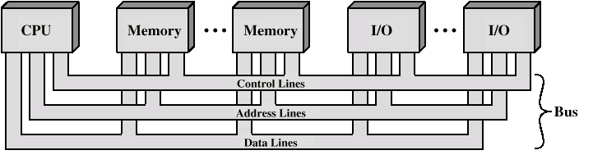
Bus Interconnection Scheme

Slide 19
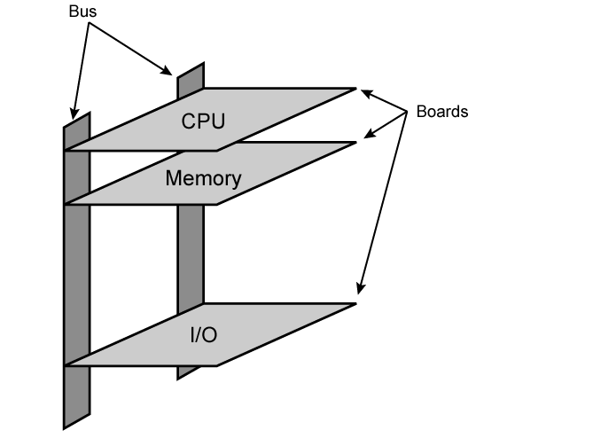
Physical Realization of Bus Architecture

Slide 20
Single Bus Problems
Lots of devices on one bus leads to:
Propagation delays
Long data paths mean that co-ordination of bus use can adversely affect performance.
If aggregate data transfer approaches bus capacity
Most systems use multiple buses, generally laid out in hierarchy, to overcome these problems

Slide 21
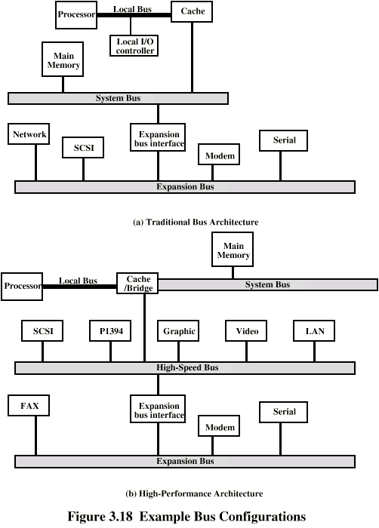
Traditional bus architecture (with cache)

Slide 22
Traditional bus architecture (with cache)
Local bus connects the processor to cache memory.
Cache memory controller connects cache to local as well as system bus, connected to memory.
Advantage: I/O transfer from/to memory on System bus do not interfere with the processor’s activity.
An expansion bus interface buffers data between the system bus and the I/O controllers on the expansion bus.
Allows system to support wide variety of I/O devices and at same time insulate memory to processor transfer from I/O traffic.

Slide 23
High Performance Bus

Slide 24
Traditional bus architecture (with cache)
Traditional bus architecture breaks down as higher performance is seen in I/O devices.
High speed bus, closely integrated with rest of the system, requiring only a bridge between processor’s bus and the high speed bus. This is known as mezzanine architecture.
High speed devices are attached to High-speed bus, rest of the devices still are connected through Expansion Bus.

Slide 25
Bus Types
Dedicated
Function Dedication: Separate data & address lines
Physical Dedication: Multiple buses, each of which connects only a subset of modules.
High throughput, but more cost.
Multiplexed
Shared lines
Address valid or data valid control line
Advantage - fewer lines
Disadvantages
More complex control

Slide 26
Bus Arbitration
More than one module controlling the bus
e.g. CPU and I.O module
Only one module may control bus at one time
Arbitration may be centralised or distributed

Slide 27
Centralised or Distributed Arbitration
Centralised
Single hardware device controlling bus access
Bus Controller
Arbiter
May be part of CPU or separate
Distributed
Each module may claim the bus
Control logic on all modules

Slide 28
Timing
Co-ordination of events on bus
Synchronous
Asynchronous
Synchronous is easy to test, but does not accommodate for the advances in device performance.

Slide 29
Timing
Synchronous
Events determined by clock signals
Control Bus includes clock line
A single 1-0 is a bus cycle
All devices can read clock line
Usually a single cycle for an event

Slide 30
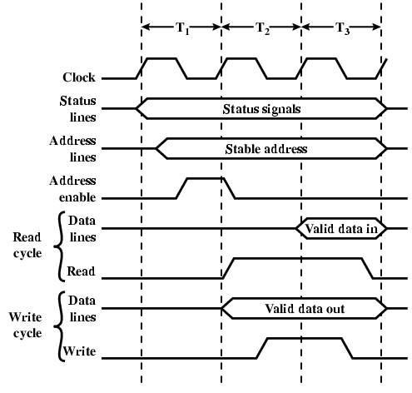
Synchronous Timing Diagram

Slide 31
Timing
Asynchronous
Occurrence of one event on a bus follows and depends on the occurrence of previous event.

Slide 32
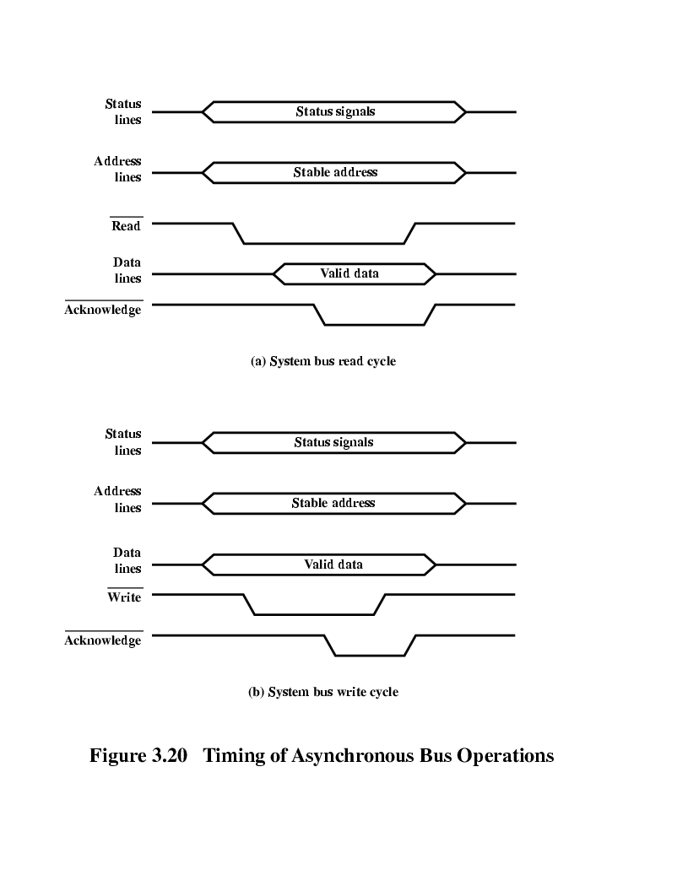
Asynchronous Timing – Read Diagram

Slide 33
Asynchronous Timing – Write Diagram

Slide 34
End of Chapter 3. Will catch on PCI Bus in any Lab.

